Slide 1
Networking Fundamentals
Foundations of Ethernet and IP

Slide 2
Physical Cabling
#
Copper and Fiber

Slide 3
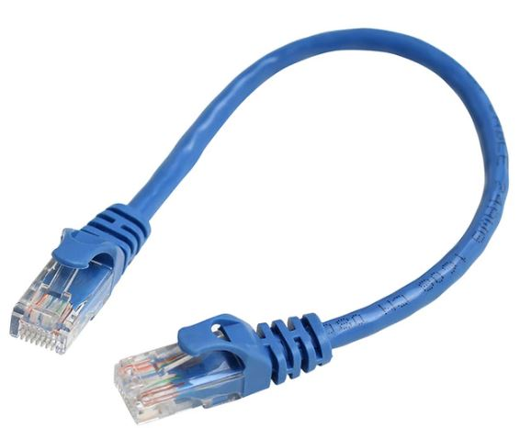
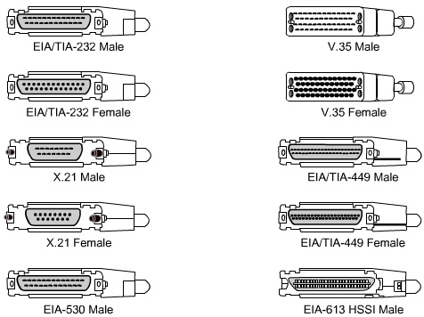
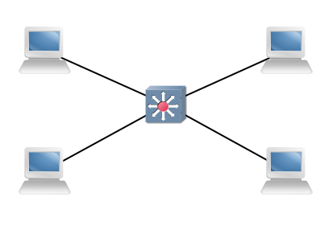

Shared Media Vs. Point to Point
Shared media ethernet networks = broadcast networks
Serial connections = point to point
Only 2 devices exist on the link

Slide 4
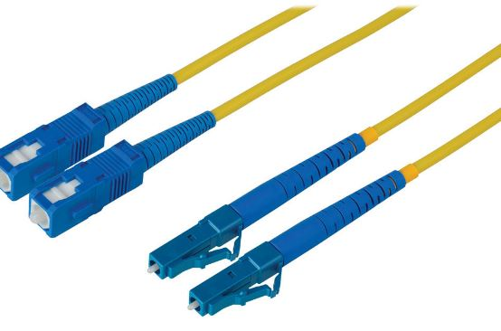
LAN Media
 | 1000BASE-T | 1000BASE-CX | 1000BASE-LX | 1000BASE-SX
Media Type | Copper | Copper | Fiber | Fiber
Standard | UTP | Coaxial | SM | MM
Max Distance | 100m | 25m | 10km | 550m

Slide 5

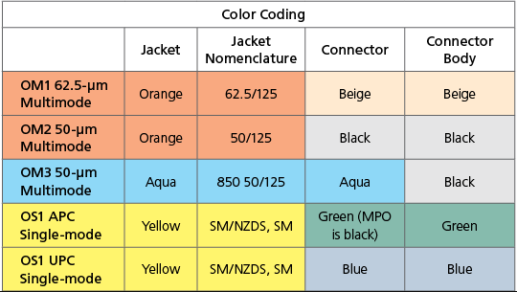
Fiber Connectors

Slide 6
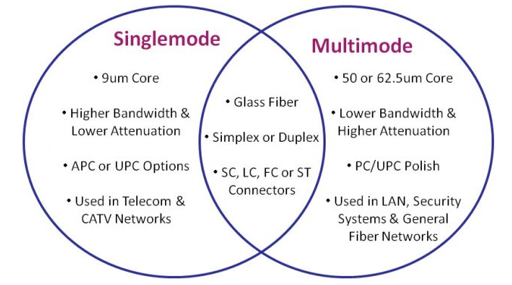
Single mode Vs. Multi-Mode
Single mode can transmit longer distances
Single mode carries 1 wavelength well
Multi-mode is typically cheaper
Multi-mode is not tuned to a single wavelength

